Slide 1


Department of software engineering
DATABASE MANAGEMENT SYSTEM
WEB hosting
Group Leader: NITesh kumar BSE-23F-105
Naveed Ahmed 23f-126
Muzzafar Ali 23f -144 Waseem Akram 23f -142
Submitted to: Miss Aqsa umer

Slide 2



Role of database in web hosting
A database plays a vital role in web hosting by storing and managing data for websites and applications, enabling dynamic content generation, user interactions, and data retrieval. It ensures data consistency, integrity, and scalability, supporting search and filtering capabilities, and facilitating efficient data manipulation and retrieval. Common databases used in web hosting include relational databases like MySQL and PostgreSQL, NoSQL databases like Mongo DB and Cassandra, and cloud databases like AWS Aurora and Google Cloud SQL, all of which enable websites to store, manage, and retrieve data efficiently

Slide 3

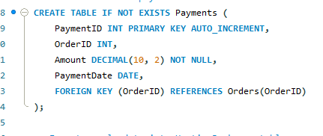
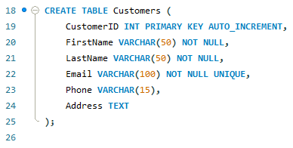
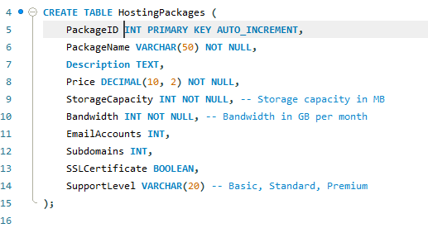
Now lets make a database of admission portal

Slide 4
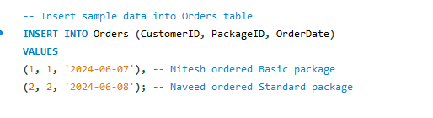
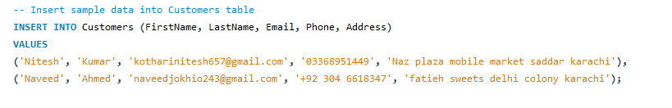
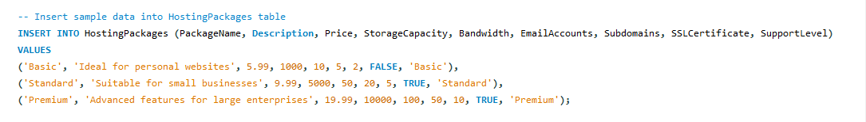
Now we have to insert values

Slide 5
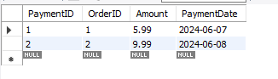
Some of quires from 50 which we have made
q.1
Output:

Slide 6
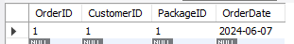
Some of quires from 50 which we have made
q.2
Output:

Slide 7

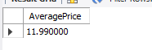
Some of quires from 50 which we have made
q.3
Output:

Slide 8

Contribution
Nitesh Kumar: 15 lines of query:
Naveed:
15 Lines of query
Muzzafar
10 lines of query
Waseem Akram 10 Lines of query

Slide 9

Thank You!

